Slide 1
A Modeling and Experimental Investigation on the Formation of Acicular Silicon and Sludge in High Pressure Die Casting of a Modified A383 Alloy
Mikko Karkkainen
University of Alabama
Department of Metallurgical and Materials Engineering
Notes:
Enter speaker notes here.

Slide 2
Contents
Introduction to HPDC (high pressure die casting)
Prediction of solidification conditions using the NovaCast Flow&Solid software
Experimental validation of model using optical micrograph measurements
Summary
Notes:
Enter speaker notes here.

Slide 3
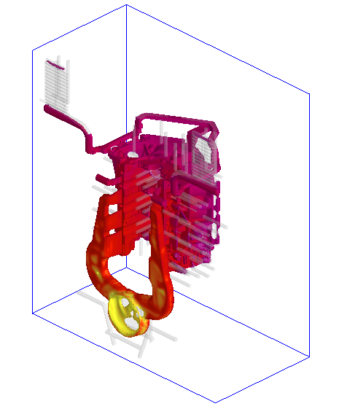
High-Pressure Die-Casting process
Pressures up to 100 Mpa
125 ms filling time
35 s removal from mould
Water cooling through channels through mould
Notes:
Enter speaker notes here.

Slide 4
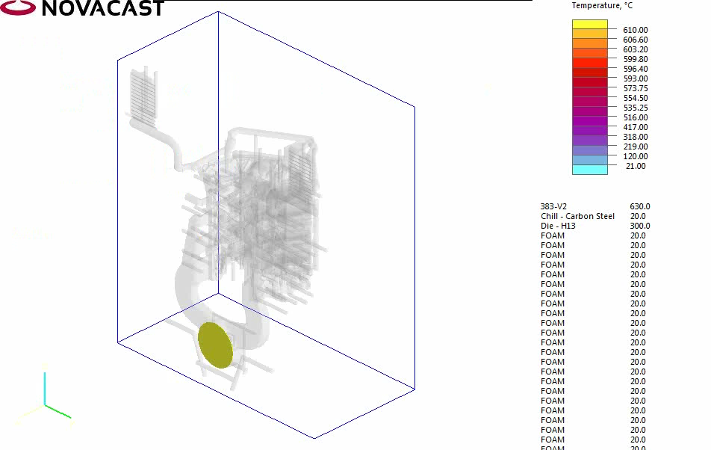
Demonstration of HPDC temperature evolution in real-time
Notes:
Enter speaker notes here.

Slide 5
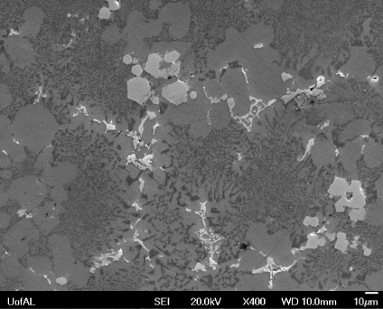
HPDC challenges: Iron
Elevated iron content (1-2%) to avoid soldering
Formation of Fe-rich intermetallics
Sludge composition:
_{Chinese script or polyhedron}
_{α-Al15(Fe, Mn, Cr)3Si2}
_{Bcc}
Al | Si | Cu | Zn | Fe | Mn | Cr | Ni
58.46 | 11.21 | 1.85 | 0.71 | 18.15 | 7.14 | 2.29 | 0.28
Notes:
Enter speaker notes here.

Slide 6
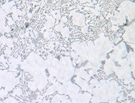
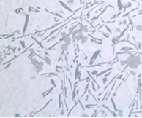
HPDC challenges: Silicon (eutectic)
Silicon is hard and acts as a stress concentrator
Effect is aggravated when Si assumes acicular (needle-like) morphology
Round
acicular
Notes:
Enter speaker notes here.

Slide 7
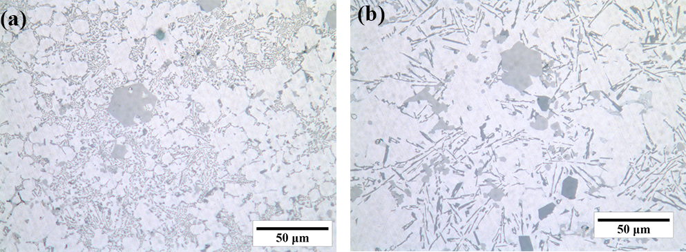

HPDC microstructure for A383
Si | Cu | Zn | Mn | Ni | Sn | Mg | Fe
10.5 | 2.5 | 1.5 | 0.5 | 0.3 | 0.15 | 0.1 | 1.0
Eutectic silicon
Primary aluminum
Primary silicon
Notes:
Enter speaker notes here.

Slide 8
Simulation of filling, cooling and solidification
Commercial software NovaCast Flow&Solid
Discretisation: Control Volume method
Gauss Seidel solver
Adaptive mesh
Notes:
Enter speaker notes here.

Slide 9


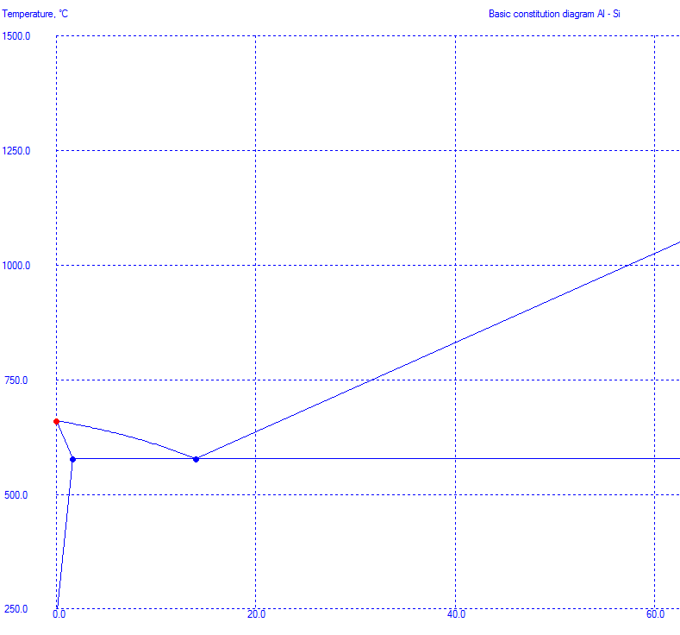
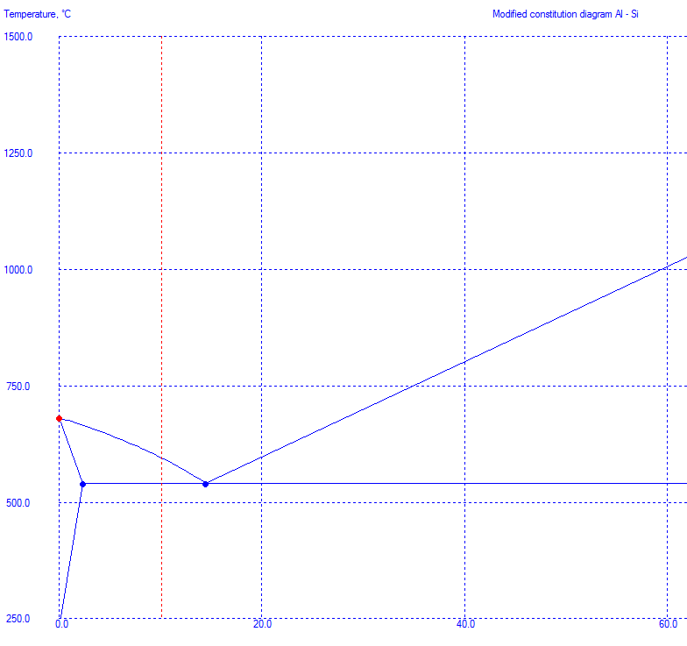
Simulation of phase stability
Si | Cu | Zn | Mn | Ni | Sn | Mg | Fe
10.5 | 2.5 | 1.5 | 0.5 | 0.3 | 0.15 | 0.1 | 1.0
Basic Al-Si phase diagram
A383 diagram with pseudobinary approach
Notes:
Enter speaker notes here.

Slide 10
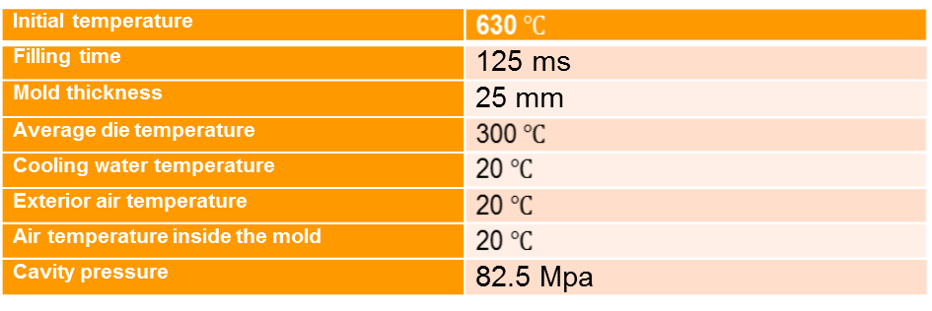
Initial conditions and boundary conditions
Convective cooling boundary condition between
  water channels and casting
  Die and exterior air
Notes:
Enter speaker notes here.

Slide 11
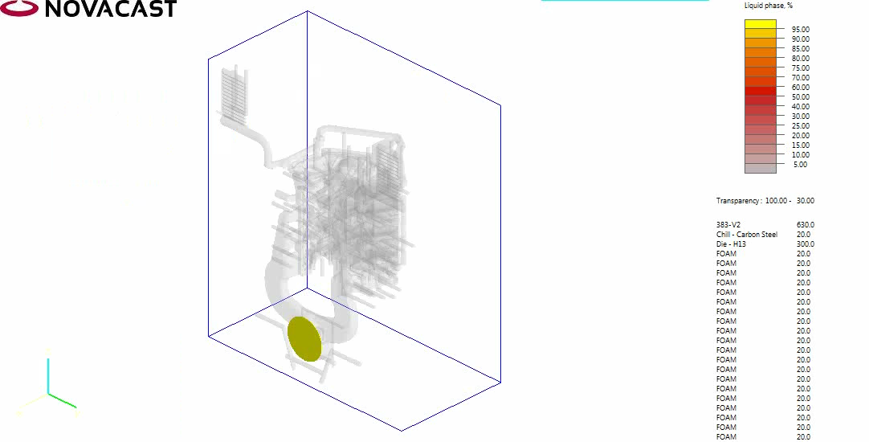
Simulation results: liquid fraction
Notes:
Enter speaker notes here.

Slide 12
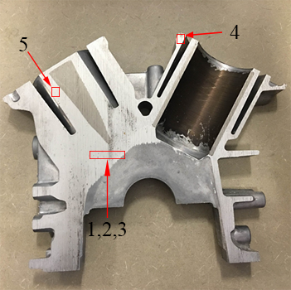
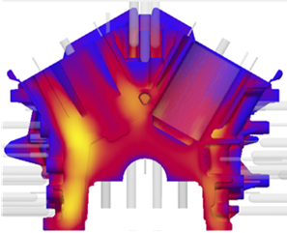
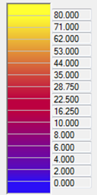
Simulation results: local solidification time
Local solidification time (s)
Sample | Cooling rate in the mushy zone, K/s
1 | 1.7
2 | 1.2
3 | 2.8
4 | 10
5 | 25
Notes:
Enter speaker notes here.

Slide 13
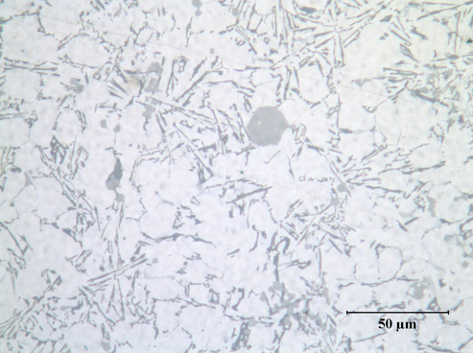
Experimental: sludge and silicon size and roundness
Optical micrographs of cut surfaces at 500x magnification
Size and roundness determined using Photoshop CS6
Notes:
Enter speaker notes here.

Slide 14
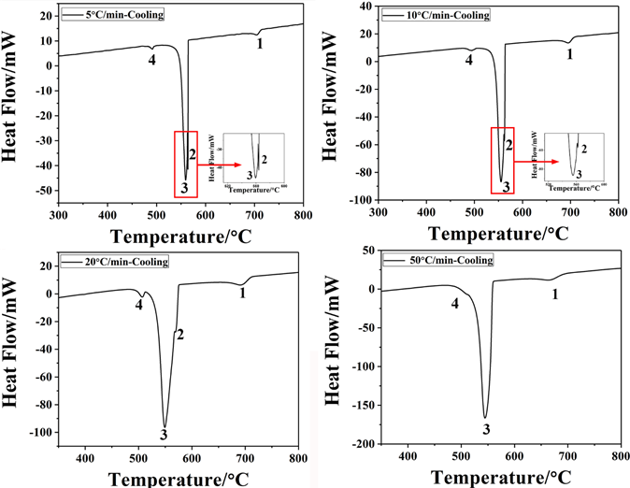
DTA: sludge formation temperature
Notes:
Enter speaker notes here.

Slide 15
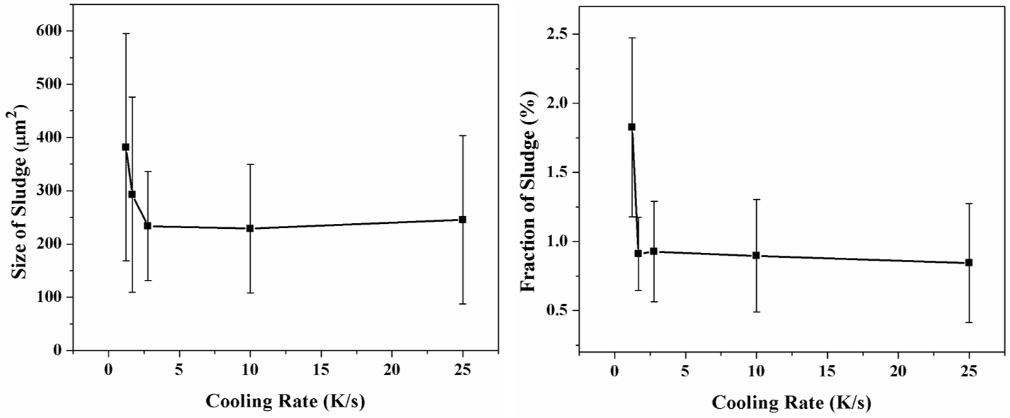
Results: Average sludge particle area and sludge area fraction
Notes:
Enter speaker notes here.

Slide 16
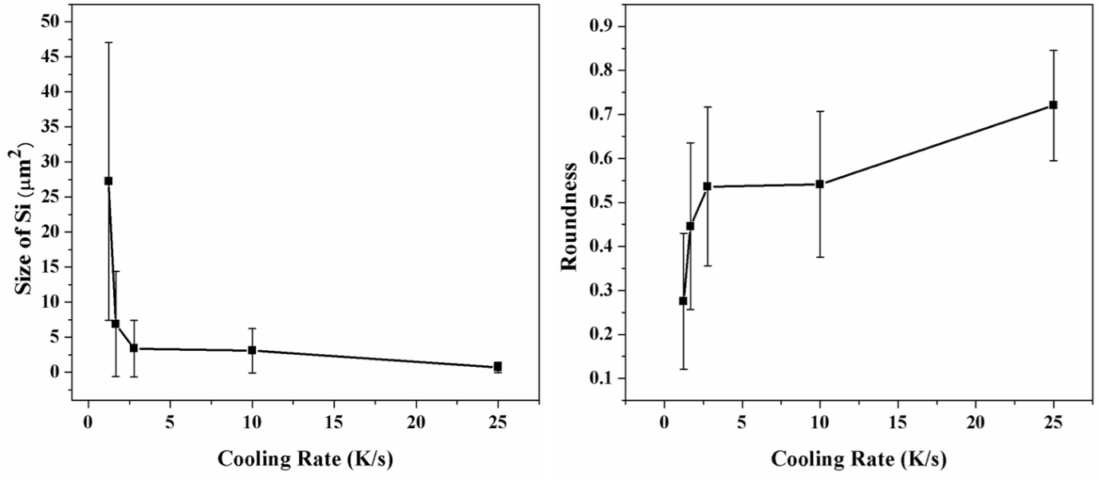
Results: Average eutectic silicon particle area and roundness
Notes:
Enter speaker notes here.

Slide 17
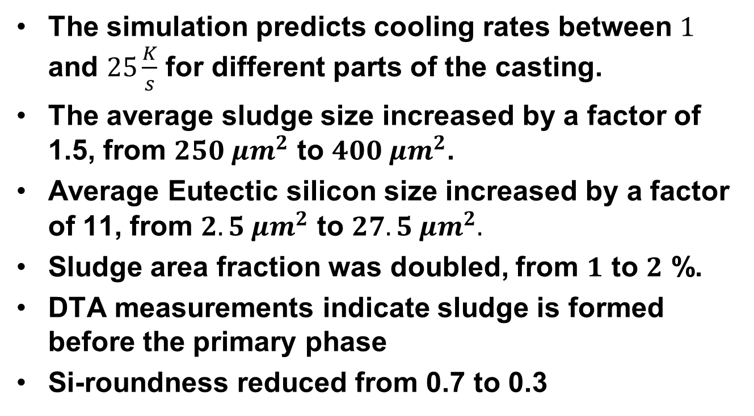
Conclusions

Slide 18
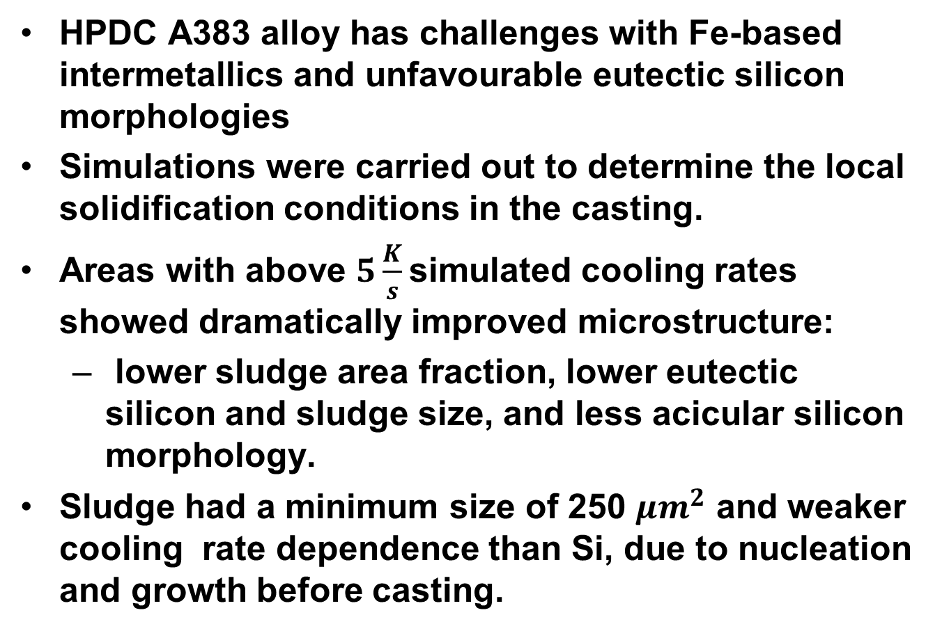
Summary
Notes:
Enter speaker notes here.

